Slide 1
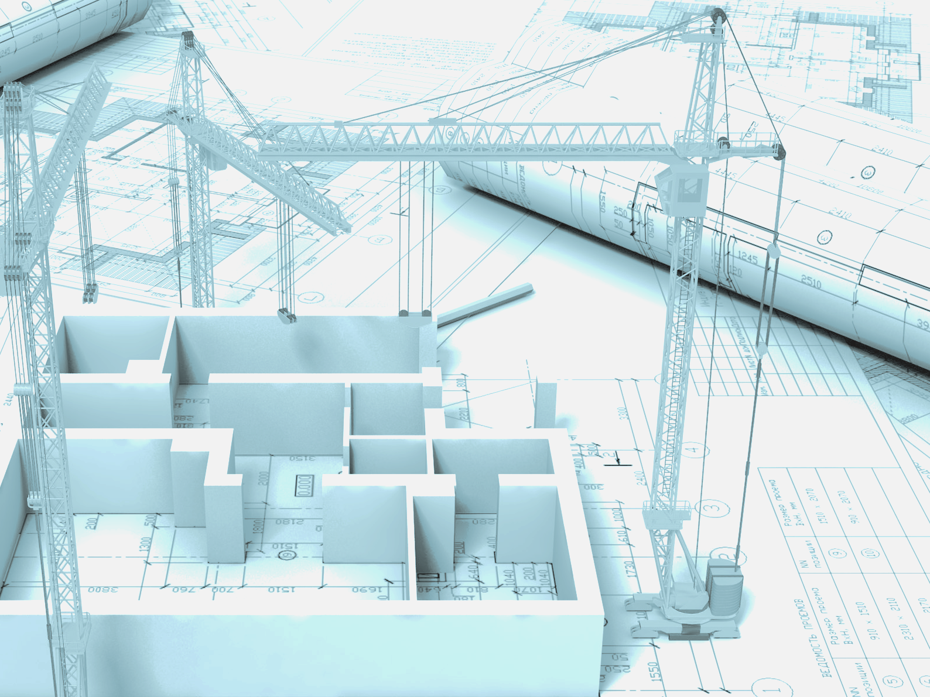
Class Diagrams & Design Patterns
CE-1103 Algorithms and Data Structures I

Slide 2
Disclaimer / Descargo de Responsabilidad
Esta presentación corresponde a una guía usada por el profesor durante las clases. La misma ha sido modificada para ser utilizado en el modelo de cursos asistidos por tecnología. No es una versión final, por lo que la misma podría requerir todavía hacer algunos ajustes. Para aspectos de evaluación esta presentación es solo una guía, por lo que el estudiante debe profundizar con el material de lectura asignado y lo discutido en clases para aspectos de evaluación.
This presentation corresponds to a guide material used by the professor during classes. It has been modified to be used in the model of technology-assisted courses. It is not a final version, so it may still require some adjustments. For evaluation aspects, this presentation is only a guide, so the student should delve with the assigned reading material and what has been discussed in class.

Slide 3
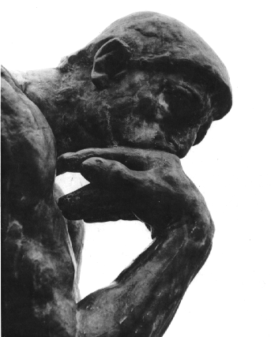
Let’s be honest...
When you receive a project specification, what do you do?
Do you start coding right away?
Do you carefully plan everything and then code?
Do you make a balance between planning and coding?

Slide 4
Let’s be honest...
Most people goes direct to code!
Too much design and thinking is for cowards! - they say
Kids code apps in their bedrooms!
Do you see any risk in this approach?

Slide 5
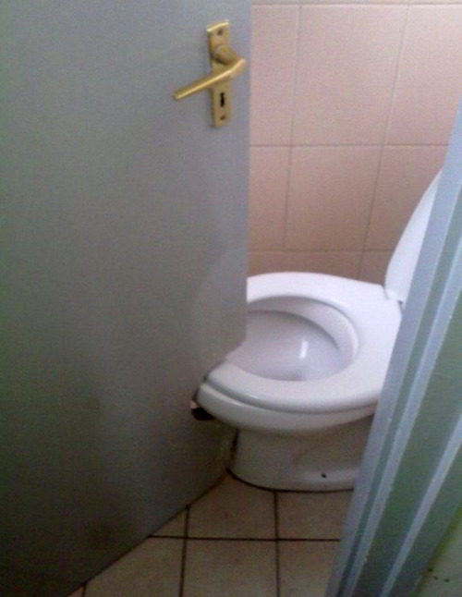
Professional vs empiric

Slide 6

Professional vs empiric

Slide 7
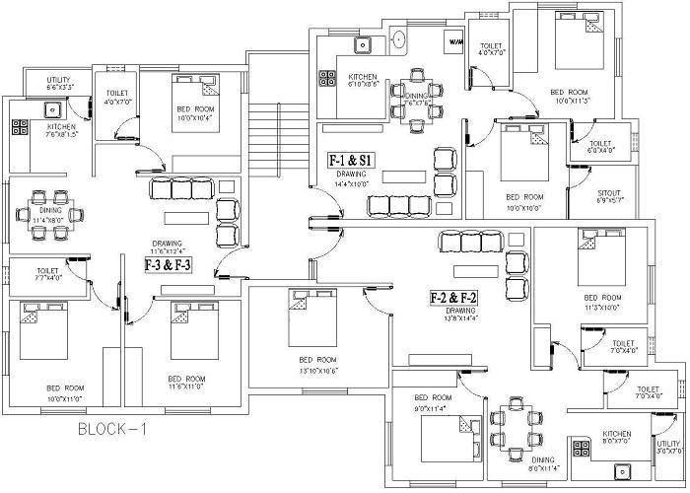
Professional vs empiric

Slide 8
For computer engineers...
There are formal ways to do ours jobs
Project management methodologies
Development methodologies
Standards and frameworks
Best practices
Tools
These are some of the things that separates an engineer from the kid coding in his room..

Slide 9
In this topic
We will focus just on:
Class diagrams
Design Patterns
Take a guess, can you explain each of these items?

Slide 10

Before going into details...
We need to have some notion of what is UML
We will revisit this topic in the next course
For now, we just need to know what it is

Slide 11

Unified Modeling Language

Slide 12
What is UML?
UML stands for Unified Modeling Language
Standard language for writing software blueprints
The usage of UML give you a professional and standard approach to create artifacts during the SDLC

Slide 13
What is UML?
UML stands for Unified Modeling Language
Standard language for writing software blueprints
The usage of UML give you a professional and standard approach to create artifacts during the SDLC
Software Development Life Cycle

Slide 14
What is UML?
Think of UML as the formal notation for computer engineers
Just like the drawings of a house blueprint can be understood by any architect, UML can be understood by any computer engineer

Slide 15
Brief history of UML
After the arrival of the OOP, many object modeling techniques started to emerge
In the years between 1989 and 1994 at least 50 object oriented methods with different modeling languages

Slide 16
Brief history of UML
In the middle of this chaos, there were three prominent methods:
Booch
OOSE (Object Oriented Software Engineering)
OMT (Object Modeling Technique)
Each of these had strengths and weaknesses

Slide 17
Brief history of UML
The authors of these three methods joined forces to unify them in one single modeling language
Grady Booch, Ivar Jacobson and James Rumbaugh created a consortium for UML
Many companies joined this consortium:
IBM, HP, Oracle, Unisys, Texas Instruments, Microsoft, among many others

Slide 18

Brief history of UML
In 1996 the first version of UML was released
Currently the Object Management Group maintains the UML standard

Slide 19
Why modeling is necessary?
We all want to build good software, so:
We build models to communicate the desired structure and behavior of our system
We build models to visualize and control the system’s architecture
We build models to better understand the system we are building
We build models to manage risk
Is not the same to build the house of a dog to build a skyscraper

Slide 20
Why modeling is necessary?
We model because is a well-accepted engineering technique!
Constructions & Architecture
Electronics
Sociology
Economics
A model is:
A simplification of reality (Abstraction)

Slide 21
Why modeling is necessary?
UML is composed of three types of models:
Functional model
Object model
Dynamic model
Each model is composed by a set of diagrams
One of the most common type of diagrams is class diagrams

Slide 22
Unified Modeling Language:
Class diagram
Also known as static view
This diagram captures the object structure. Includes all the data structures and the operations on the data
It does not contains any information related to the dynamic behavior
Run time

Slide 23
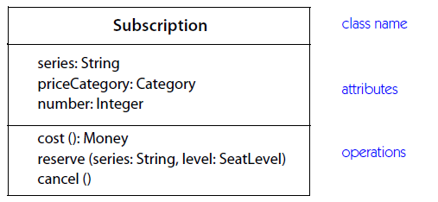
Unified Modeling Language:
Class diagram
A class is represented as:

Slide 24
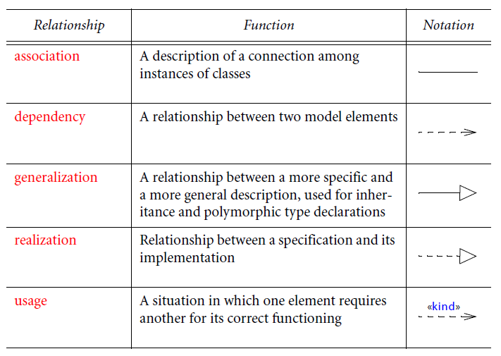
Unified Modeling Language:
Class diagram

Slide 25
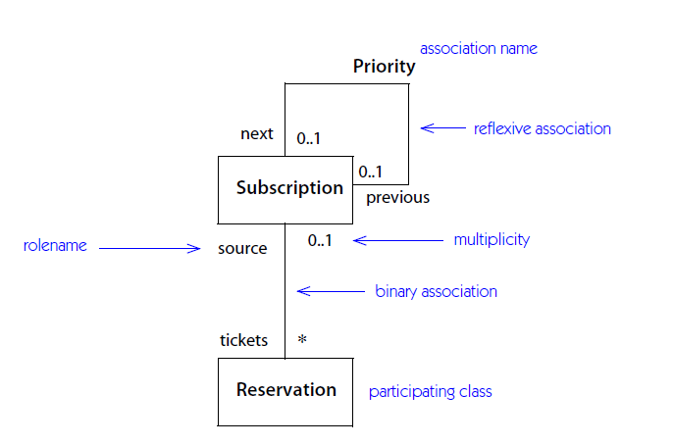
Unified Modeling Language:
Class diagram: Association

Slide 26
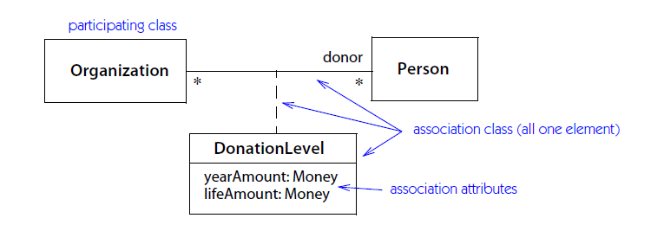
Unified Modeling Language:
Class diagram: Association

Slide 27
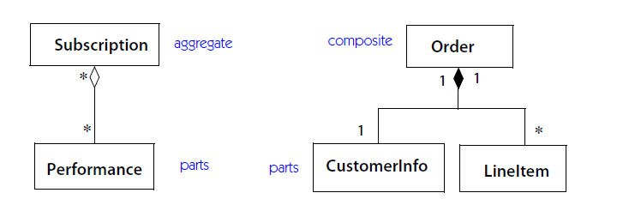
Unified Modeling Language:
Class diagram: Association

Slide 28
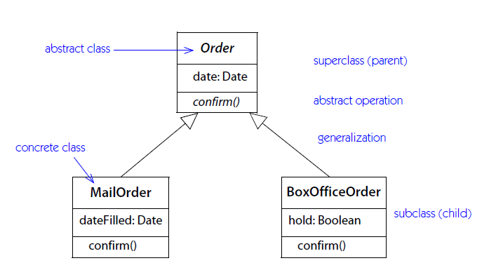
Unified Modeling Language:
Class diagram: Generalization

Slide 29
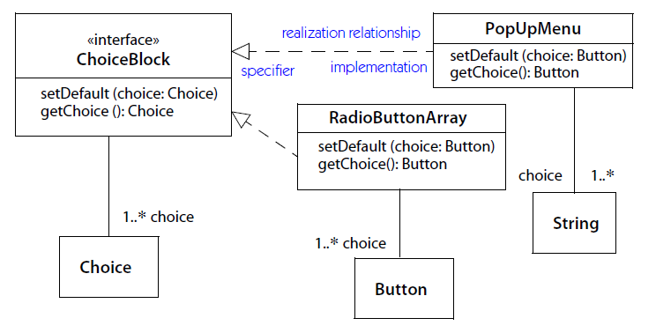
Unified Modeling Language:
Class diagram: Realization

Slide 30
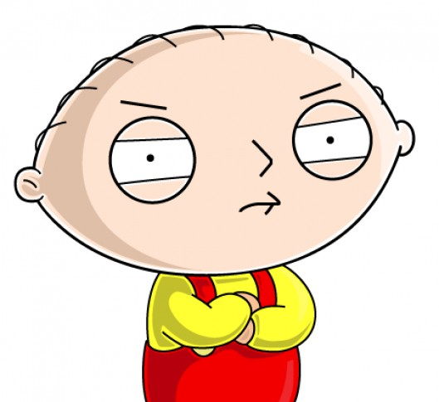
Where can I create class diagrams?

Slide 31

Unified Modeling Language:
Class diagram: Tools
There are many commercial and open source tools that you can use to create class diagrams.
Some even generate code from the diagram (forward engineering) or generate diagrams from existing code (reverse engineering)

Slide 32
Unified Modeling Language:
Class diagram: Tools
Some useful tools are:
Microsoft Visio
Lucid Chart (Cloud-based solution)
IBM Rational Software Architect
Eclipse plugins
DIA

Slide 33

Object-Oriented Design

Slide 34

Let’s pause for a moment...
Like most things in life, there is more than one way of doing things
Solving one problem may have many different solutions

Slide 35
Let’s pause for a moment...
What is a good design of a solution?
Now, in terms of software, what is a good design?
It depends of the “eye of the beholder!”

Slide 36
Let’s pause for a moment...
Although there is some level of subjectivity in the term “good”, there are some principles of what is good
So now the question is: how can I achieve a good design in OOP?

Slide 37
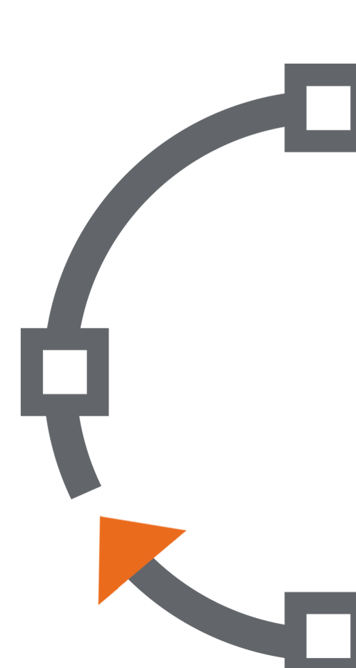
Object-oriented design
Object-oriented design is a process that can help you create “good” designs for OOP
It also involves a set of principles that can give you a sense of correctness in your work

Slide 38
Object-oriented design
This OOD process will start after the project has received “green light”
You will learn more about development projects and project management in time…
For now OOD will be enough

Slide 39
Object-oriented design
OK...let’s assume you have a problem you need to solve using OOP...how do you tackle it? Where do you start?

Slide 40
Object-oriented design
Conceptual modeling
Start by understanding the domain of the problem and create a conceptual model
This conceptual model can be done however you feel better, it doesn’t have to be elaborated
Make sure you understand!!

Slide 41
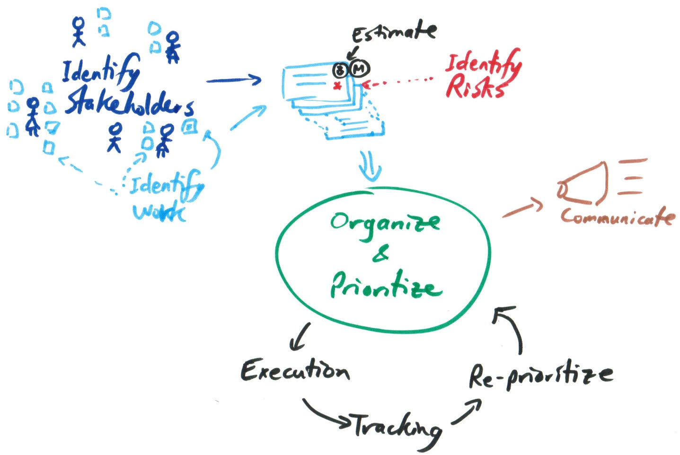
Object-oriented design
Conceptual modeling

Slide 42
Object-oriented design
Conceptual modeling
You want to gain insights of how the current problem fits in the bigger picture
So an overall diagram will do the trick...

Slide 43
Object-oriented design
Analysis phase
In this phase you need to do a deeper research to understand what you need to do
Most of the time is not clear of what he/she wants…
You can use user stories

Slide 44
Object-oriented design
Analysis phase
User stories are a simple way to collect requirements. For example:
As a user, I want to upload photos so that I can share photos with others.
As an administrator, I want toapprove photos before they are posted so that I can make sure they are appropriate.

Slide 45
Object-oriented design
Analysis phase
Another useful tool to help you understanding the problem is creating prototypes
A prototype is a very basic version of the system or solution you want to build. The main objective is show users how the final solution might look

Slide 46
Object-oriented design
Design phase
Is the final step of the OOD process. With the data you have recovered before, you can now begin creating your design
The output of this phase is the class diagram
This phase can be done in steps

Slide 47
Object-oriented design
Design phase
Step #1: Identify classes
Pay special attention on the substantives in the user stories
Never try to find all classes at once or think that everything will be do at first attempt
In software things tend to evolve iteratively

Slide 48
Object-oriented design
Design phase
Step #1: Identify classes
You may even identify candidate classes that will be remove later…
The final solution can look totally different from the first sketches
Sometime very useful to do is to assign the responsibilities to each class. A class should have only one responsibility

Slide 49
Object-oriented design
Design phase
Step #2: Identify Associations
Identify how the classes interact between each other. For example, you may find that the Car class needs the class Engine or the class Break
Finding associations may result in removing classes or adding new ones
Classes should not be isolated

Slide 50
Object-oriented design
Design phase
Step #3: Identify Attributes and Methods
Add the attributes and methods to each identified class.
Try to think from an overall point of view and seeing how each class will play its role. This will help you identifying its behavior and attributes

Slide 51
Object-oriented design
At first creating an OOP design is a hard task
As time goes by, you’ll become more and more experienced and the process will become more natural

Slide 52
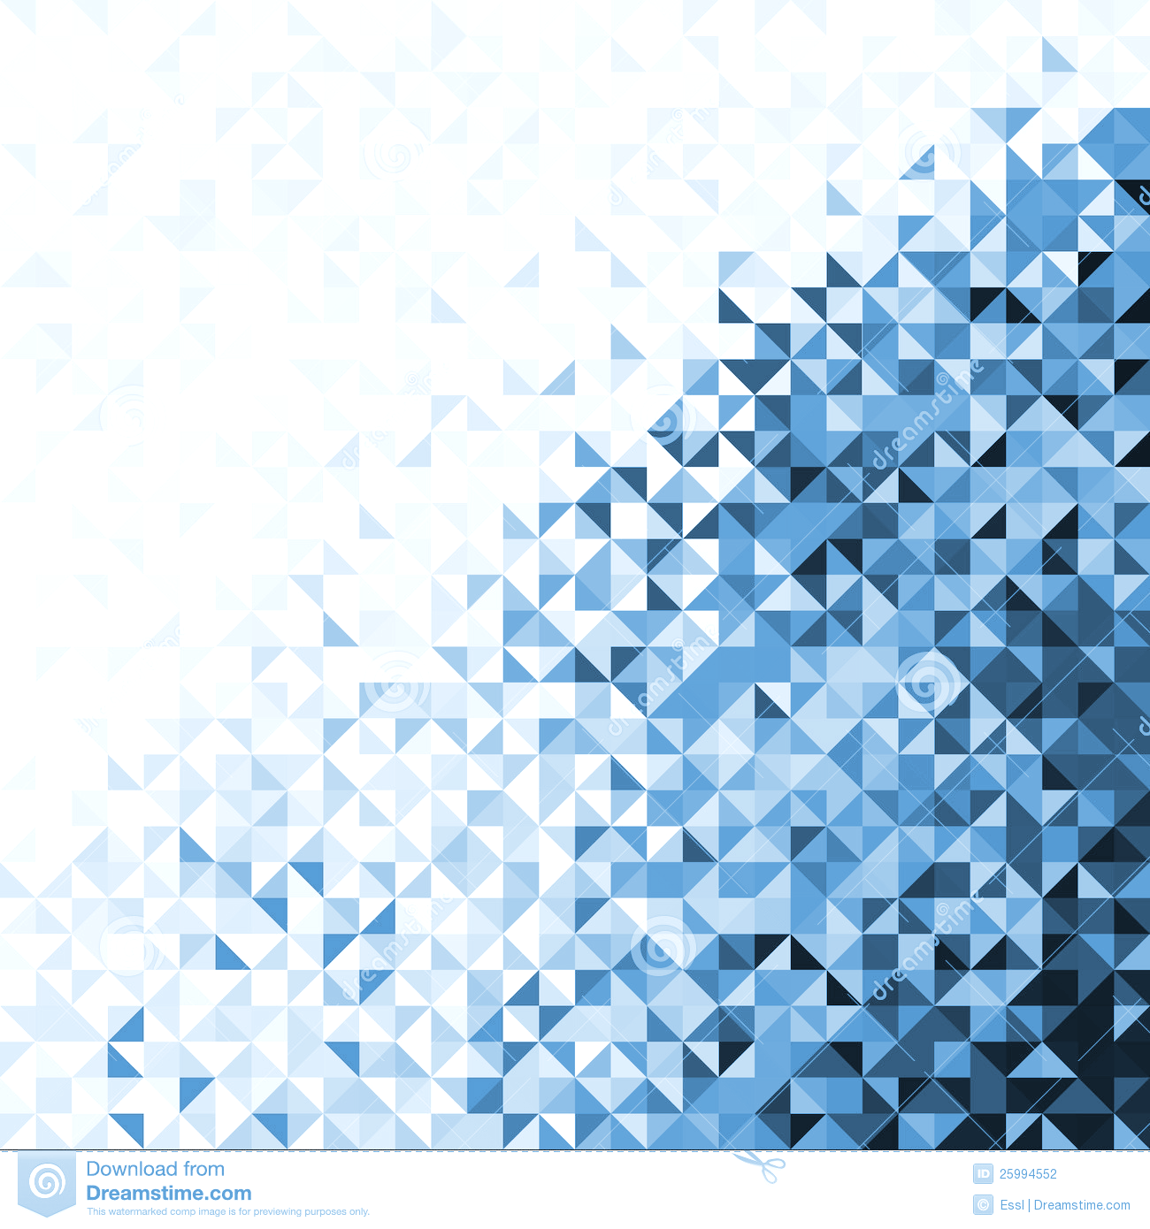
Design Patterns

Slide 53
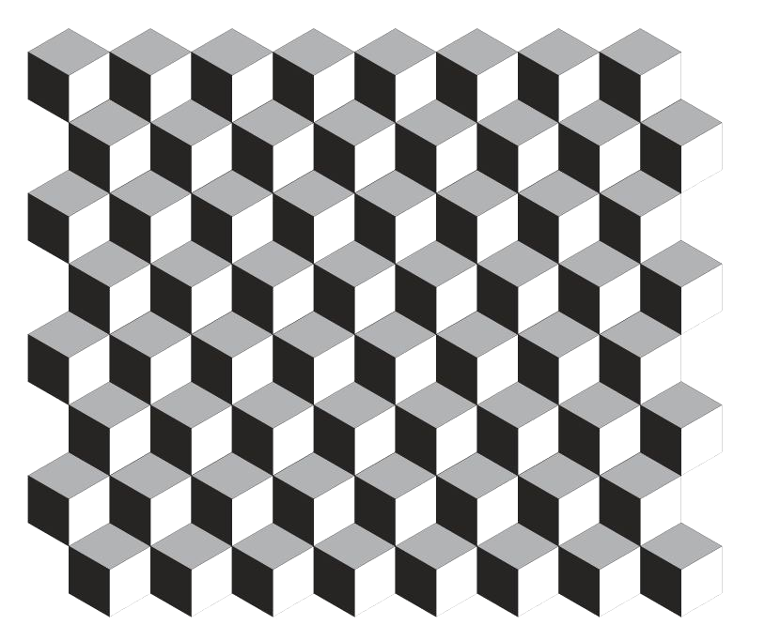

What is a pattern?

Slide 54
What is a pattern?
This image is partially visible

Slide 55
What is a pattern?
Can you tell what is behind the squares?

Slide 56
What is a pattern?
How did you do it?
That was easy!

Slide 57
What is a pattern?
Is a discernible regularity in the world or in a manmade design - Wikipedia
One thing an expert designer know not to do is solve every problem from first principles
Why?
Does this make sense to you?
Have you heard the old saying: don’t reinvent the wheel?

Slide 58
What is a pattern?
Experts designers reuse solutions that have worked for them in the past
Base new designs on prior experience

Slide 59
What is a pattern?
Experts designers reuse solutions that have worked for them in the past
Base new designs on prior experience
But every problem is unique!!

Slide 60
What is a pattern?
Experts designers reuse solutions that have worked for them in the past
Base new designs on prior experience
Experience will let you know when a solution applies or not
But every problem is unique!!
Not every known solution applies for all problems

Slide 61
Design patterns in the OOP context
Is a general reusable solution to a commonly occurring problem with a given context in software design
A pattern contains a description of communicating objects and classes that are customized to solve a general design problem in a particular context

Slide 62
Design patterns in the OOP context
A pattern can be thought as a good practice, a proven solution for a problem
Design patterns are usually known by many software professionals across the world.

Slide 63
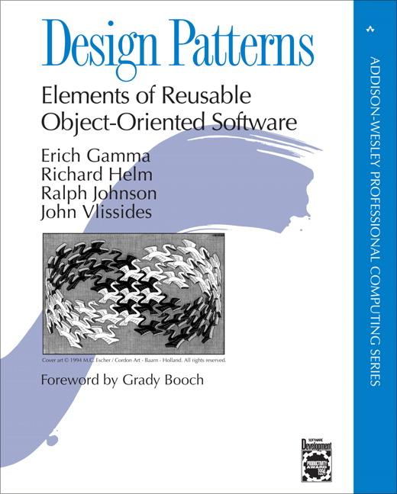
Design patterns: History background
The first catalog of design patterns was recompiled in 1994 by “the gang of four”:
Erich Gamma
Richard Helm
Ralph Johnson
John Vlissides

Slide 64
Design patterns: History background
They recompile best practices known informally by many engineers
Also they proposed patterns designed by themselfs
The book has become a classic and a reference for all software engineers

Slide 65
Design patterns: Categories
Patterns can be classified by two criteria: purpose and scope.
Purpose reflect what a pattern does
Scope specifies if the pattern applies to classes or objects

Slide 66
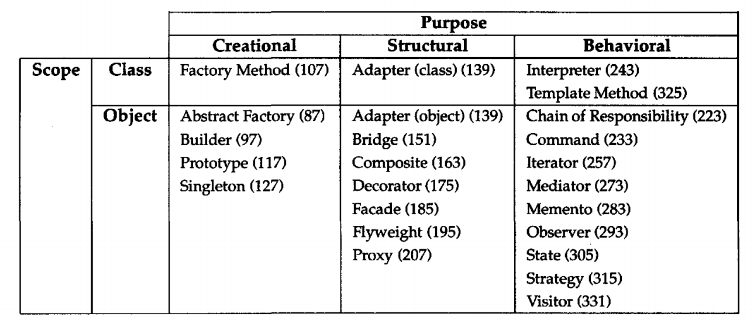
Design patterns: Categories

Slide 67
Design patterns: Categories
Concerns the process of object creation

Slide 68
Design patterns: Categories
Deals with the composition of classes or objects

Slide 69
Design patterns: Categories
Characterize the ways in which classes or objects interact and distribute responsibility

Slide 70
Design patterns: Categories
Deal with relationship between classes and subclases

Slide 71
Design patterns: Categories
Deal with relationship between objects which can be changed in run-time

Slide 72
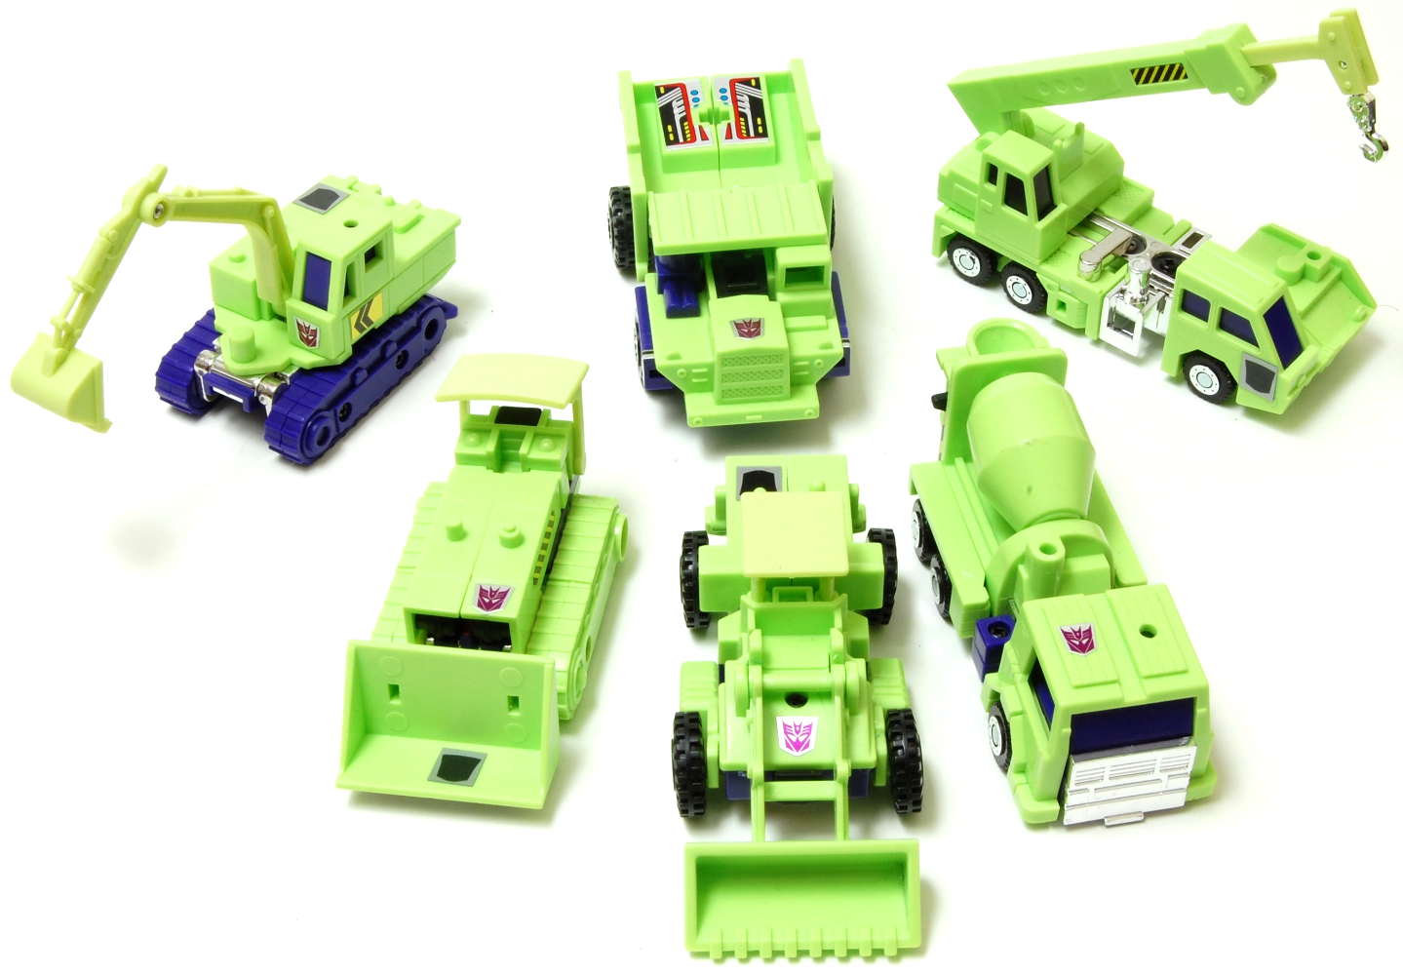
Creational patterns
Abstracts the instantiation process
Help make a system independent of how its objects are created, composed and represented.

Slide 73
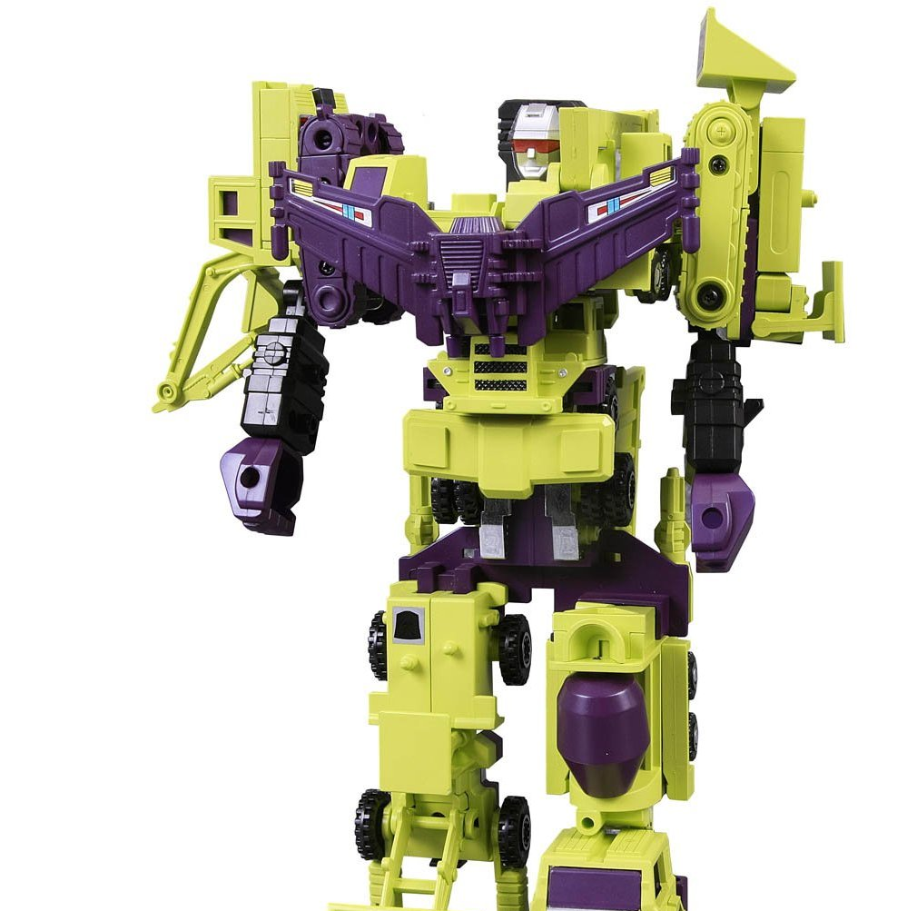
Creational patterns
Two main focuses:
Encapsulates the knowledge about which concrete classes the system uses
Hides how instances of the classes are created and put together

Slide 74

Creational patterns
Singleton
Purpose:
Ensure that a class has one instance and provide a global point of access to it
Singleton ensures that no other instance of a class can be created
Singleton provides a way to access the instance

Slide 75
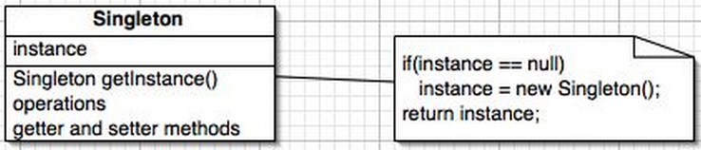
Creational patterns
Singleton
Structure:

Slide 76
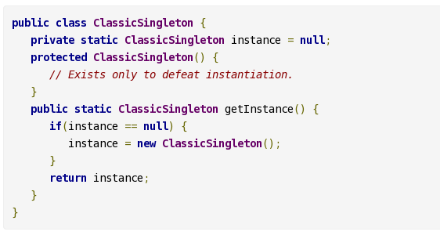
Creational patterns
Singleton
Structure:

Slide 77
Creational patterns
Singleton
Collaborations:
Singleton class defines an Instance static method that let clients access its unique instance.
Singleton is in charge of creating its own instance
Clients access the singleton only through the Instance method

Slide 78
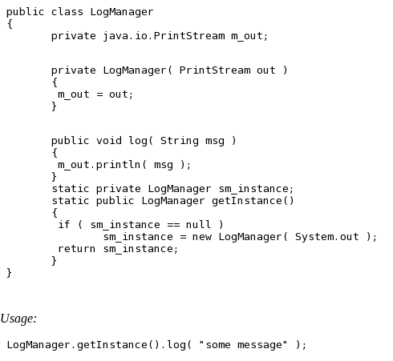
Creational patterns
Singleton
Example:

Slide 79
Creational patterns
Singleton
Apply when:
There must be exactly one instance of a class and it must be accessible from a well-known access point

Slide 80
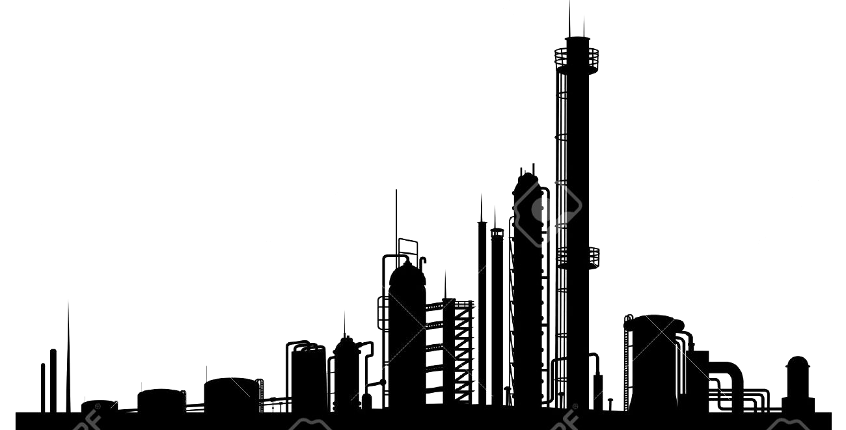
Creational patterns
Abstract Factory
Purpose:
Provide an interface for creating families of related or dependent objects without specifying their concrete class

Slide 81
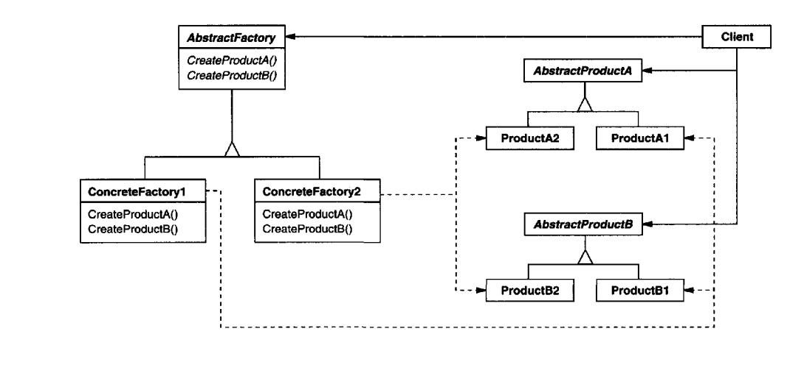
Creational patterns
Abstract Factory
Structure:

Slide 82
Creational patterns
Abstract Factory
Collaborations:
Normally a single instance of a ConcreteFactory is created at run-time
The concrete factory creates product object having a particular implementation
To create different product objects, clients should use a different concrete factory
Abstract Factory defers creation to its ConcreteFactory

Slide 83
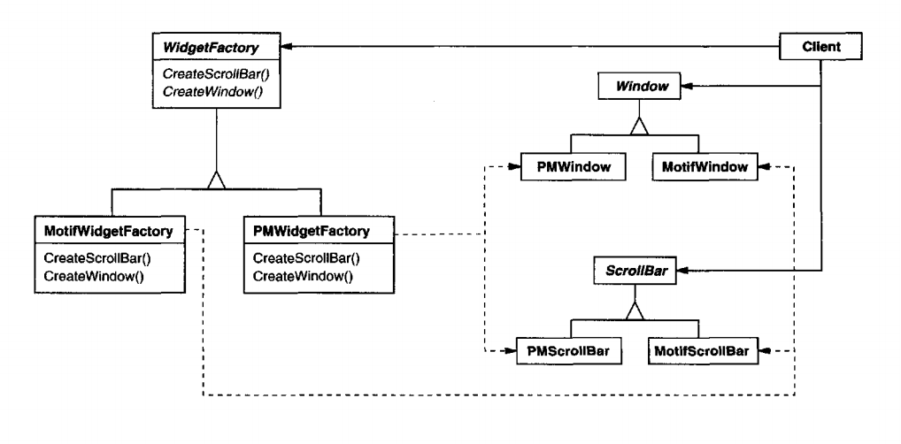
Creational patterns
Abstract Factory
Example:

Slide 84
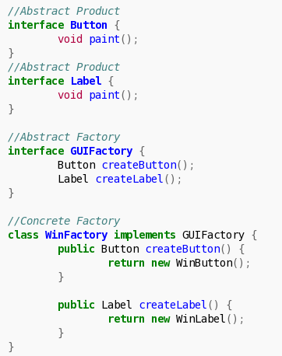
Creational patterns
Abstract Factory
Example:

Slide 85
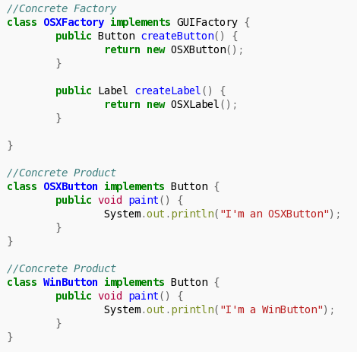
Creational patterns
Abstract Factory
Example:

Slide 86
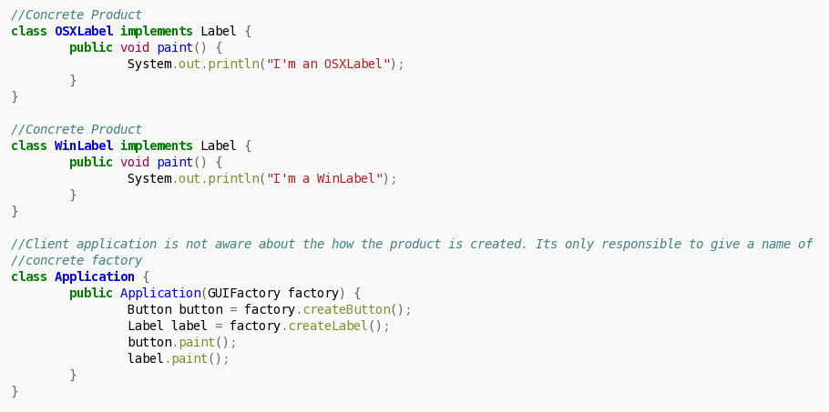
Creational patterns
Abstract Factory
Example:

Slide 87
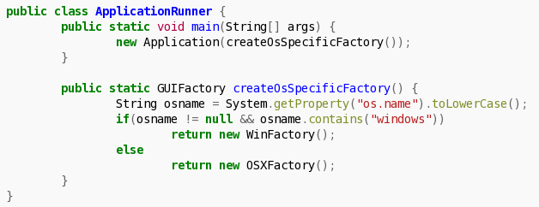
Creational patterns
Abstract Factory
Example:

Slide 88
Creational patterns
Abstract Factory
Apply when:
A system should be independent of how its products are created, composed and represented
A system should be configured with one of multiple families of products
A family of related product objects is designed to be used together and you need to enforce this constraint
You want to provide a class library of products and you want to reveal just their interfaces, not their implementation

Slide 89
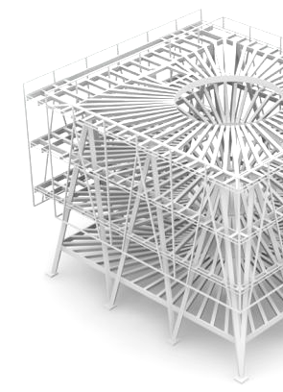
Structural patterns
Are concerned with how classes and objects are composed to form larger structures
Describe ways to compose objects to realize new functionalities
Change composition at run-time

Slide 90
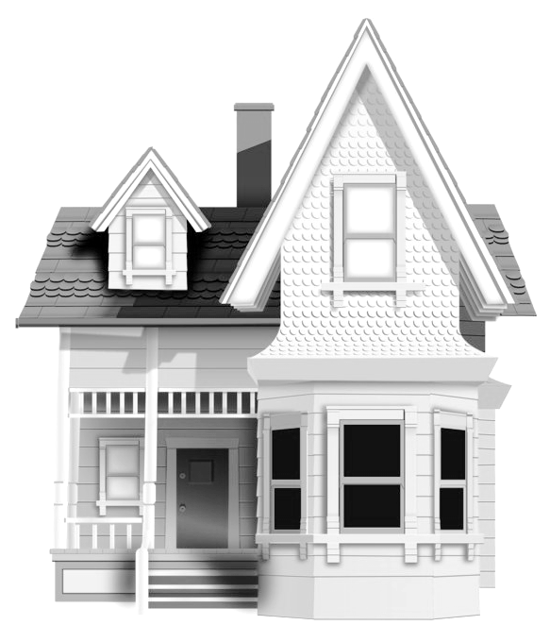
Structural Patterns: Facade
Purpose:
"Provide a unified interface to a set of interfaces in a subsystem. Facade defines a higher level interface that makes subsystem easier to use"

Slide 91
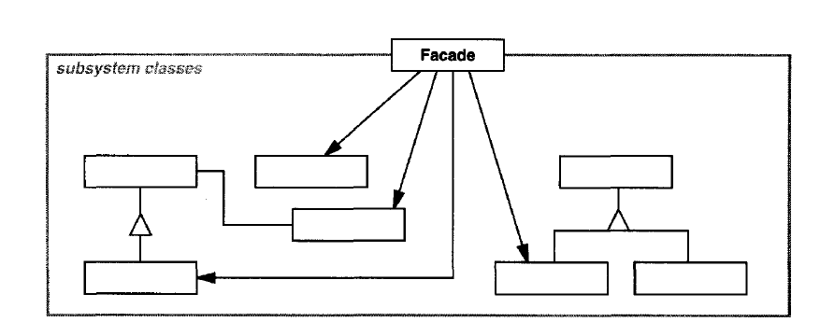
Structural Patterns: Facade
Structure:

Slide 92
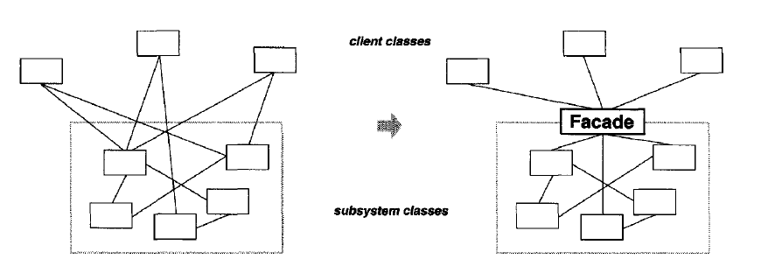
Structural Patterns: Facade
Structure:

Slide 93
Structural Patterns: Facade
Collaborations:
Clients communicate with the subsystem by sending request to Facade, which forwards to the appropriate subsystem objects
Clients that use the facade don't have access to its subsystem objects directly

Slide 94
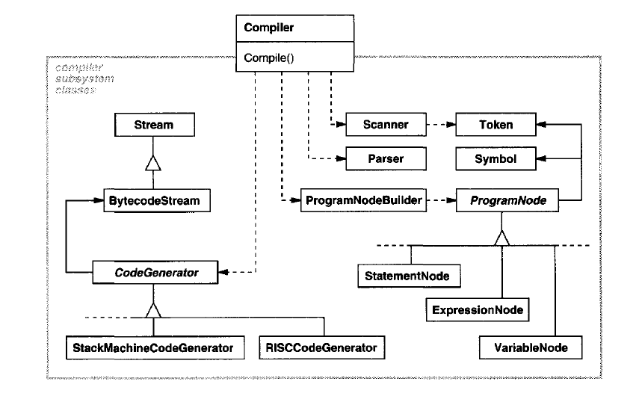
Structural Patterns: Facade
Example:

Slide 95
Structural Patterns: Facade
Apply it when:
You want to provide a simple interface to a complex subsystem
You want to give a simple default view of the subsystem that is good enough for the clients
There are many dependencies between clients and the implementation classes. Facade decouples the subsystem from clients
You want to define an entry point to a subsystem while hiding complexity

Slide 96
Structural Patterns: Facade
Consequences:
Shields client from the subsystem components, making the subsystem easier to use
Promotes weak coupling between clients and subsystems
Don't prevent clients from using subsystem classes directly

Slide 97
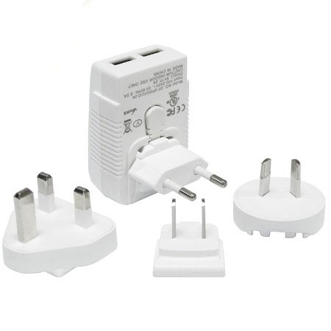
Structural Patterns: Adapter
Purpose:
"Convert the interface of a class into another interface clients expect. Adapter lets classes work together that couldn't otherwise because of incompatible interfaces."

Slide 98
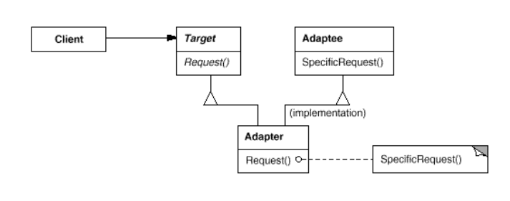
Structural Patterns: Adapter
Structure:
Class level

Slide 99
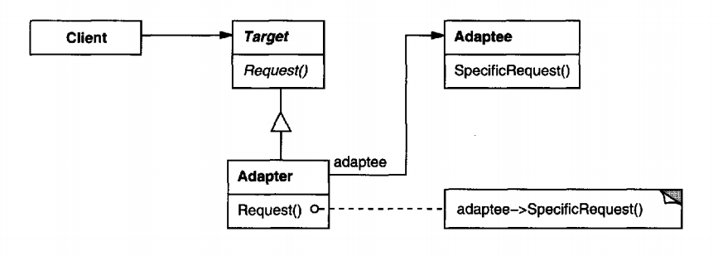
Structural Patterns: Adapter
Structure:
Object level

Slide 100
Structural Patterns: Adapter
Collaborations:
Clients call operations on an Adapter instance. In turn the adapter calls adaptee operations that carry out the request

Slide 101
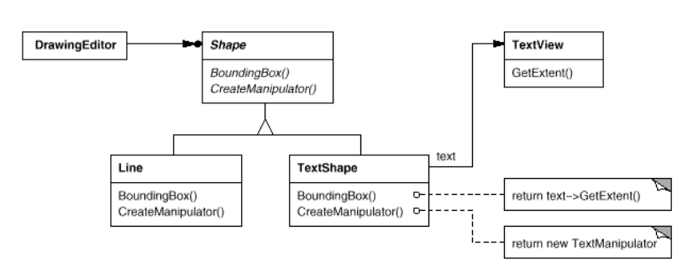
Structural Patterns: Adapter
Example:

Slide 102
Structural Patterns: Adapter
Apply it when:
You want to use an existing class, and its interface does not match the one you need.
You want to create a reusable class that cooperates with unrelated or unforeseen classes, that is, classes that don't necessarily have compatible interfaces.
(object adapter only) You need to use several existing subclasses, but it's impractical to adapt their interface by subclassing everyone.

Slide 103
Structural Patterns: Adapter
Consequences on class adapter:
Won't work when we want to adapt a class and all its subclasses
Lets override some of Adaptee's behavior
Consequences on object adapter:
The Adapter can also add functionality to all adaptees (all subclasses) at once.
Harder to override adaptee behavior

Slide 104

Behavioral Patterns
Are concerned with algorithms and the assignment of responsibilities between objects
Describe the patterns of communication between classes or objects
Let you concentrate on the interconnection between objects

Slide 105
Behavioral Patterns: Observer
Purpose:
"Define a one-to-many dependency between objects so that when one object changes state, all its dependents are notified and updated automatically"

Slide 106
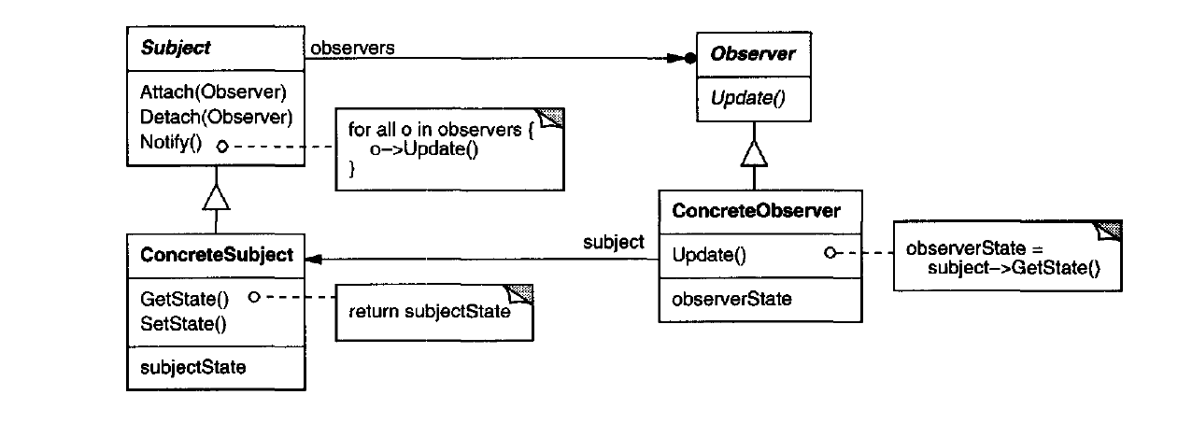
Behavioral Patterns: Observer
Structure:

Slide 107
Behavioral Patterns: Observer
Collaborations:
ConcreteSubject notifies its observers whenever a change occurs that could make its observers' state inconsistent with its own
After being informed of a change in the concrete subject, a ConcreteObserver may query the subject for information

Slide 108
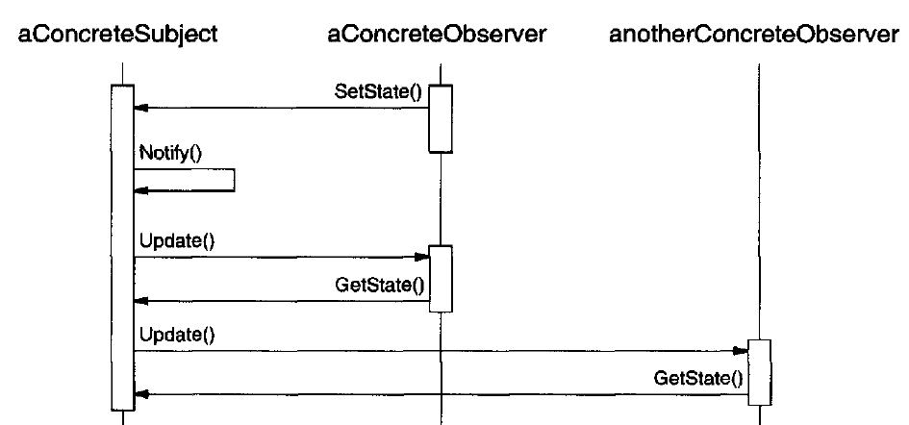
Behavioral Patterns: Observer
Collaborations:

Slide 109
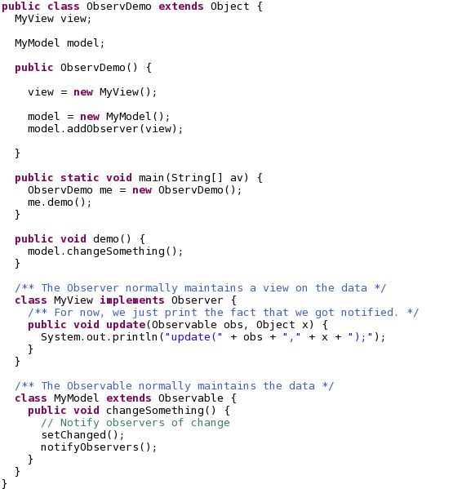
Behavioral Patterns: Observer
Example:

Slide 110
Behavioral Patterns: Observer
Apply when:
An abstractions has two aspects: one dependent on the other
A change to one object requires changing others and you don't know how many others are
An object should be able to notify other objects without making assumptions who they are

Slide 111
Behavioral Patterns: Observer
Consequences:
Decouples subject and observer
Supports broadcast communication
Unexpected updates: observers have no knowledge of each other's presence they don't know the cost of each change for the overall system
Is hard for observers know what changed

Slide 112
Design patterns
Why do we need design patterns?

Slide 113
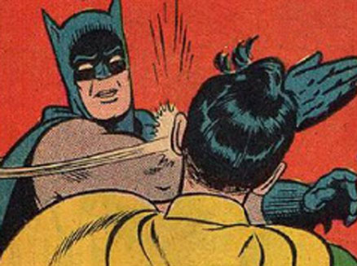

Slide 114
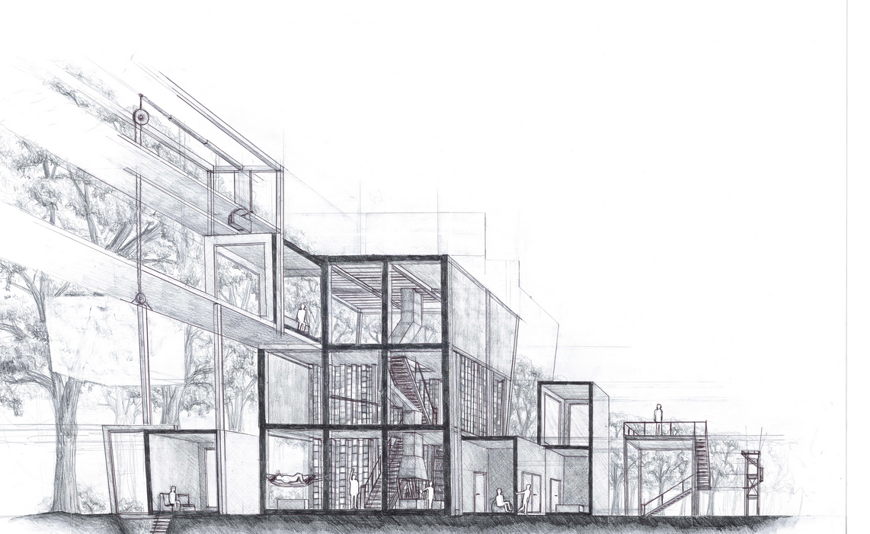
Architectural Patterns:
Model-View-Controller

Slide 115
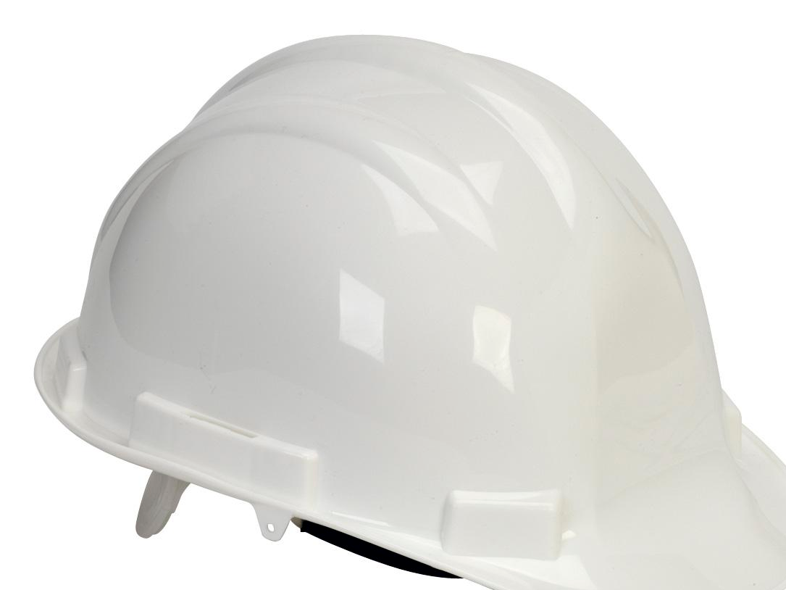
Architectural patterns
We learned that design patterns are good practices of how to structure software at the class level
Design patterns are applied at the design phase of a system

Slide 116
Architectural patterns
Before design starts, software architects define the architecture of the system
Architecture involves defining the components of the system. Components are the pieces of the system

Slide 117
Architectural patterns
The architecture is at a higher level than the design. So design patterns are not considered in this phase
Analogous to the design patterns, there are architectural patterns

Slide 118
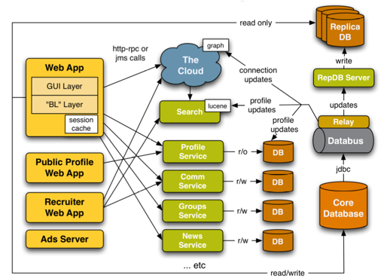
Architectural patterns
Architectural diagram

Slide 119

Model-View-Controller (MVC)
MVC is one of the most common architectural patterns for implementing user interfaces
Divides the system in three separated parts
It has become an standard for web development

Slide 120
Model-View-Controller (MVC)
Controller sends commands to the model to update the model's state. It can also sends commands to the view to update the representation of the model
Contains the main logic of the application and the flow of the user interaction

Slide 121
Model-View-Controller (MVC)
Model stores data that is retrieved to the controller and displayed in the view. When a change in the data occurs, the controller updates the model
Model usually represent the database tables or any other source of persistent data

Slide 122
Model-View-Controller (MVC)
View request information from the model that it uses to generate an output representation to the user
For example, a view in a web application is an HTML file that the user interacts with

Slide 123
Class Diagrams & Design Patterns
CE-1103 Algorithms and Data Structures I

